Slide 1
Video and Audio Calling Web Application
ECM2001 Data Communications and Networks
J Component Review 2
Team Genisys
19BLC1037 Shivansh
19BLC1046 Pratyush Motha
Faculty:
Dr. Jayavignesh

Slide 2
Software Used
WebRTC for real time audio video communication
React.JS for making web frontend
Node.JS to power backend
Socket.io for real-time communication (passing signals)
Browser APIs to access web camera and microphone

Slide 3
Current Progress
Generate a unique meeting code
Join Users in a Room for audio and video enabled call.

Slide 4
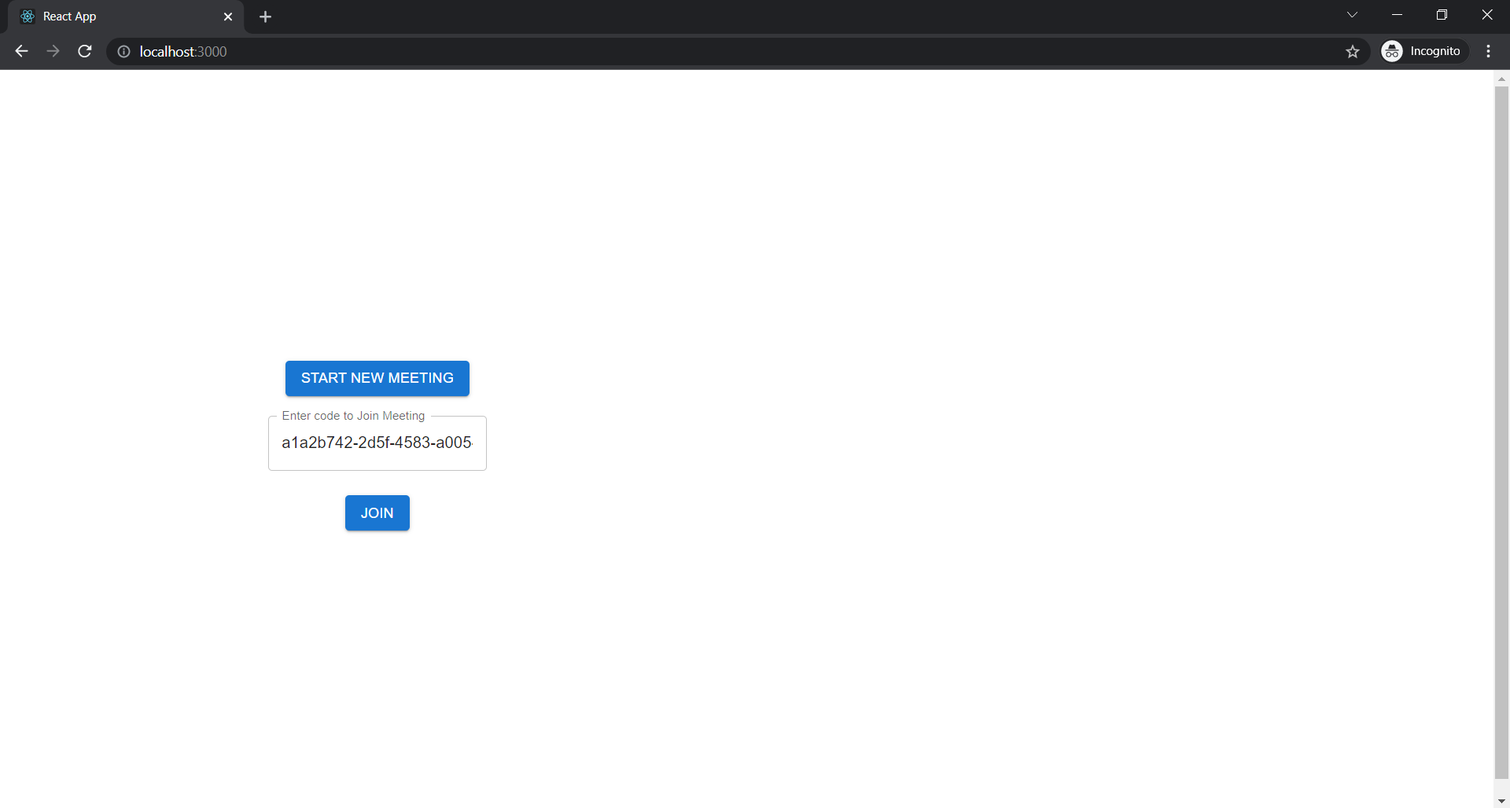
Click on START NEW MEETING button to generate new meeting code and then click on JOIN to join the meeting.
If you already have a code and want to join the meeting, directly enter the code in Input box and click on JOIN to join the meeting.

Slide 5
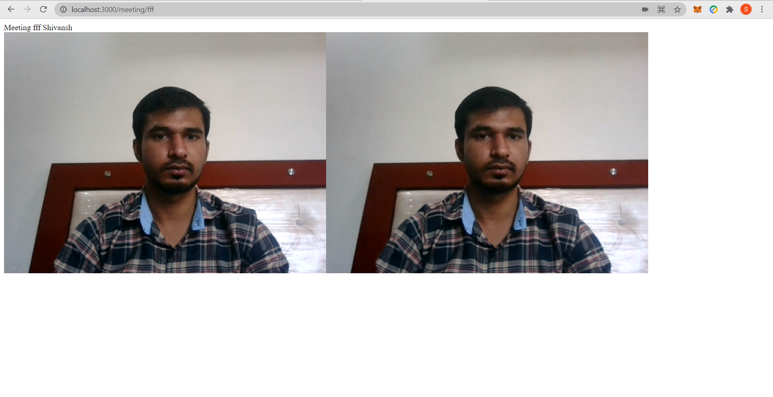
As the application is running on localhost so for testing purpose, we have joined the same meeting room from incognito tab, this is how it looks when 2 users join at the same time.

Slide 6
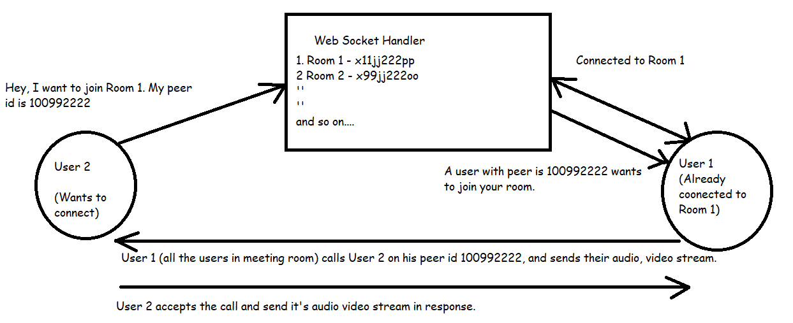
Working of System

Slide 7
Timeline
Research about required modules | Before Review 1
Implementation where users can join for a video calling. | Before Review 2
Adding Authentication In the application and finalising the product | Before Review 3

Slide 8


Team Members

Slide 9
Thankyou

